Slide 1
What is user interface ?
Visual part of computer application or operating system through which a user interacts with a computer or a software. It determines how commands are given to the computer or the program and how information is displayed on the screen.

Slide 2
What is database ?
A database is a collection of information that is organized so that it can be easily accessed, managed and updated.
Data is organized into rows, columns and tables, and it is indexed to make it easier to find relevant information.
Data gets updated, expanded and deleted as new information is added.
Databases process workloads to create and update themselves,
querying the data they contain and running applications against it.
Computer databases typically contain aggregations of data records or files,
such as sales transactions, product catalogs and inventories, and customer profiles.

Slide 3
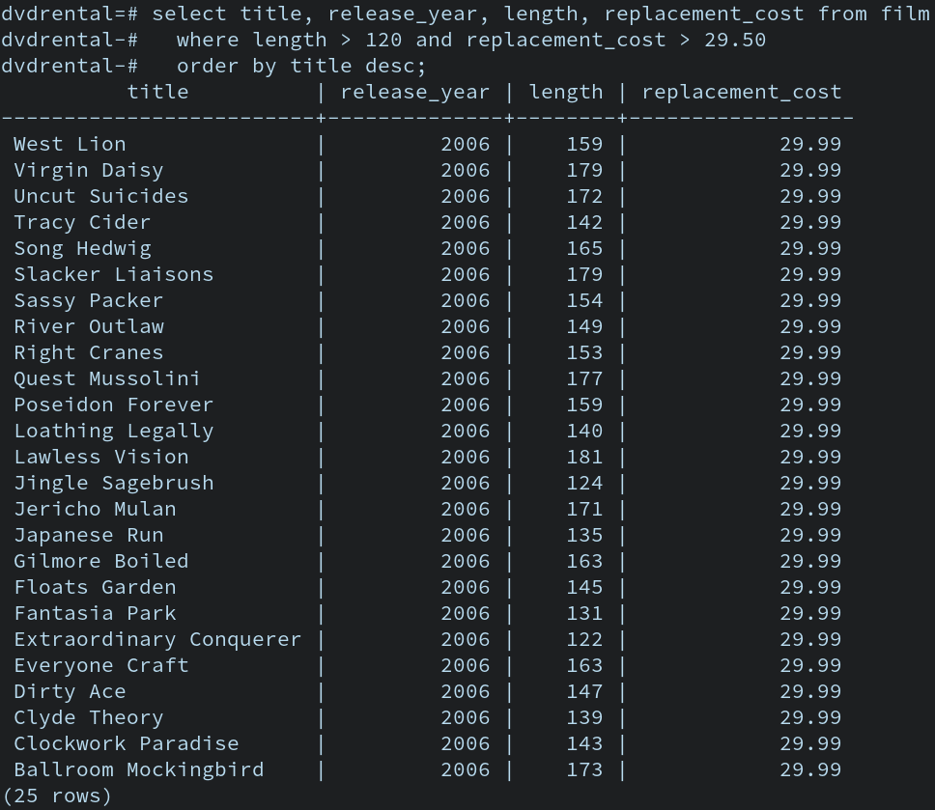

Slide 4
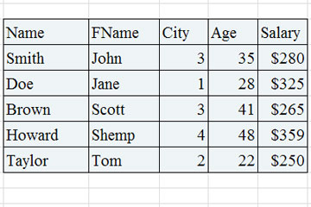

Slide 5
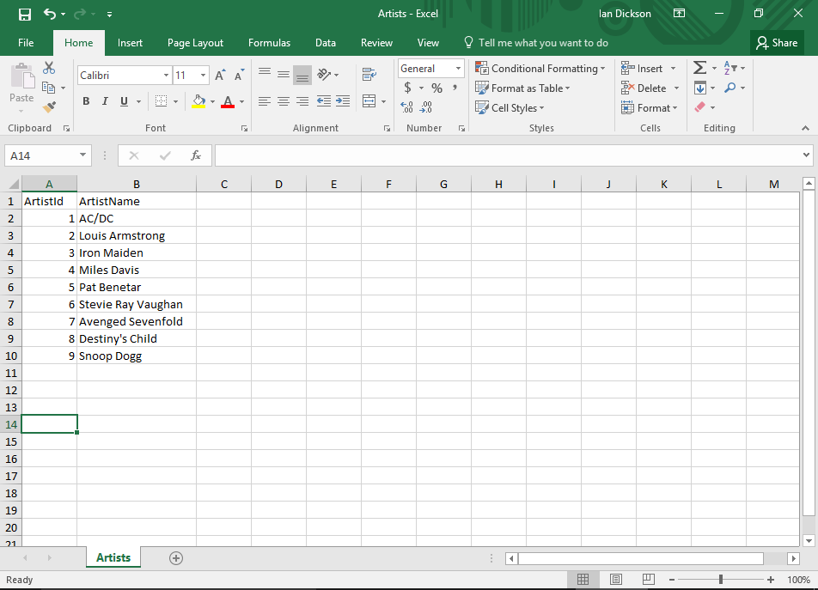

Slide 6
What is web services?
A simple definition: A web service is a function that can be accessed by other programs over the web (HTTP).

Slide 7
What is backend code?
Backend development is not all ones and zeros though. Much like frontend development, backend development has a human aspect to it as well. Since most of the code for an application is written on the backend, it should be easy to understand and work with. Most backend languages – like Ruby and Python – have standardized styles and idioms that make reading and writing code more efficient and enjoyable.

Slide 8
Java
C++
Python

Slide 9
The backend of a web application is an enabler for a frontend experience. An application’s frontend may be the most beautifully crafted web page, but if the application itself doesn’t work, the application will be a failure. The backend of an application is responsible for things like calculations, business logic, database interactions, and performance. Most of the code that is required to make an application work will be done on the backend. Backend code is run on the server, as opposed to the client. This means that backend developers not only need to understand programming languages and databases, but they must have an understanding of server architecture as well. If an application is slow, crashes often, or constantly throws errors at users, it’s likely because of backend problems.

Slide 11
Applications
Computer applications are basically programs or software which perform a function/Task
Web Based Applications
Windows Based Applications

Slide 12
Client/Presentation Layer
This is the layer we see when we use a software
The main functionality of this layer is to communicate with Application layer
This layer passes the information which is given by the user in terms of keyboard actions, mouse clicks to the Application Layer

Slide 13
Database Layer
The data is stored in this layer
Application layer communicates with Database layer to retrieve the data

Slide 14
Application Layer
Application layer receives information from Presentation layer
Application layer interacts with Database layer and sends required information to the Presentation layer.
It controls an application’s functionality by performing detailed processing
Complete business logic will be written in this layer.

Slide 15
Windows Application
Windows Application is a user build an application that can run on a Windows platform. The windows application
has a graphical user interface that is provided by Windows Forms. Windows forms provide a variety of
controls including Button, TextBox, Radio Button
, CheckBox, and other data and connection controls. You can easily design a web application using an IDE Microsoft Visual Studio
using a variety of languages including C#, Visual Basic, C++, J# and many more.

Slide 16
Web Application
It is a type of application that runs on a browser using a Web server configured with Microsoft Internet Information Services (IIS). In .NET, all web applications are
built around ASP.NET, which is nothing but a part of the .NET platform and includes design-time objects and controls and a run-time execution
context. ASP.NET helps in building a wide variety of web application from a traditional website that serves HTML pages to a high-end business application
that runs on the Internet.

Slide 17
Team
Project manager .
Software testers
Developers
Business Analyst .

Slide 18
Structure of the course
Very interactive
I want everyone to participate by asking questions & answering my questions
Many of the questions I ask in class can be potential interview questions!
There will be weekly assignments that will be due by the following Sunday after the Wednesday when the work is assigned
Homework will be posted on the forum under the section titled “PeopleNTech Action Items Given by Instructors”
Homework must be submitted to Homework@PeopleNTech.Com
If you have any questions regarding the homework (or any other topic covered in class):
1st step: GOOGLE!!! On the job, you won’t be able to ask your classmates or instructors for help. MAKE GOOGLE YOUR BEST FRIEND!
2nd step: Collaborate with your classmates. Make study groups and practice with each other
3rd step: Contact me via email – Saleem.piit@gmail.com
Quizzes and In-Class Labs
There will be a 5-question quiz every other week which will cover material discussed the previous 2 weeks and also some material which will be covered that week.
Everyone attending the class must have access to the PeopleNTech Forum as the Homework Assignments will be given through the Forum platform. All students must also register for the Webinar Sessions as in-class quizzes and tests will be given through the Webinar. This includes anyone attending the class from any PNT campus location.

